Slide 1
UNIT –IV Java as Object Oriented Programming Language-Overview
PRINCIPLES OF PROGRAMMING LANGUAGES
PPL - SE SEM II (2016-17)

Slide 2
Syllabus
Java History, Java Features, Java and Internet, Java and Word Wide Web, Web Browsers, Java Virtual Machine,
Data Types and Size (Signed vs. Unsigned, User Defined vs. Primitive Data Types, Explicit Pointer type)
Arrays: one dimensional array, multi-dimensional array, alternative array declaration statements.
Control Statements Revision of identical selection Statements in brief (if, else if, Nested if, Switch, Nested Switch), Iterative Statements For Each version of For Loop, Declaring Loop Control Variables Inside the for loop, Using comma in for loop), Jump Statements (Labeled Break and Labeled Continue),
String Handling: String class methods.

Slide 3
About Java Technology
Java was conceived by James Gosling, Patrick Naughton, Chris Wath , Ed frank and Mike Sheridan.
Java technology is both a programming language and a platform.
Java is CASE SENSITIVE!!

Slide 4
Java History
In 1995
It was known as “Oak” and renamed to java.
developed at Sun Microsystems
simpler to use than C++ in many ways
Used in many web-based applications
Widely used for programming devices like video game consoles, BluRay players, smart phones, etc.
Designed to allow identical code to produce the same results on many different platforms

Slide 5
Features/ Characteristics of Java
Java Is Simple
Java Is Object-Oriented
Java Is Distributed
Java Is Interpreted
Java Is Robust
Java Is Secure
Java Is Architecture-Neutral
Java Is Portable
Java's Performance
Java Is Multithreaded
Java Is Dynamic

Slide 6
Characteristics of Java
Java Is Simple
Java Is Object-Oriented
Java Is Distributed
Java Is Interpreted
Java Is Robust
Java Is Secure
Java Is Architecture-Neutral
Java Is Portable
Java's Performance
Java Is Multithreaded
Java Is Dynamic
Java is partially modeled on C++, but greatly simplified and improved. Some people refer to Java as "C++--" because it is like C++ but with more functionality and fewer negative aspects.

Slide 7
Characteristics of Java
Java is inherently object-oriented. Although many object-oriented languages began strictly as procedural languages, Java was designed from the start to be object-oriented. Object-oriented programming (OOP) is a popular programming approach that is replacing traditional procedural programming techniques.
One of the central issues in software development is how to reuse code. Object-oriented programming provides great flexibility, modularity, clarity, and reusability through encapsulation, inheritance, and polymorphism.
Java Is Simple
Java Is Object-Oriented
Java Is Distributed
Java Is Interpreted
Java Is Robust
Java Is Secure
Java Is Architecture-Neutral
Java Is Portable
Java's Performance
Java Is Multithreaded
Java Is Dynamic

Slide 8
Characteristics of Java
Java Is Simple
Java Is Object-Oriented
Java Is Distributed
Java Is Interpreted
Java Is Robust
Java Is Secure
Java Is Architecture-Neutral
Java Is Portable
Java's Performance
Java Is Multithreaded
Java Is Dynamic
Distributed computing involves several computers working together on a network. Java is designed to make distributed computing easy.
Since networking capability is inherently integrated into Java, writing network programs is like sending and receiving data to and from a file.

Slide 9
Characteristics of Java
Java Is Simple
Java Is Object-Oriented
Java Is Distributed
Java Is Interpreted
Java Is Robust
Java Is Secure
Java Is Architecture-Neutral
Java Is Portable
Java's Performance
Java Is Multithreaded
Java Is Dynamic
You need an interpreter to run Java programs.
The programs are compiled into the Java Virtual Machine code called bytecode.
The bytecode is machine-independent and can run on any machine that has a Java interpreter, which is part of the Java Virtual Machine (JVM).

Slide 10
Characteristics of Java
Java Is Simple
Java Is Object-Oriented
Java Is Distributed
Java Is Interpreted
Java Is Robust
Java Is Secure
Java Is Architecture-Neutral
Java Is Portable
Java's Performance
Java Is Multithreaded
Java Is Dynamic
Java compilers can detect many problems that would first show up at execution time in other languages.
Java has eliminated certain types of error-prone programming constructs found in other languages.
Java has a runtime exception-handling feature to provide programming support for robustness.

Slide 11
Characteristics of Java
Java Is Simple
Java Is Object-Oriented
Java Is Distributed
Java Is Interpreted
Java Is Robust
Java Is Secure
Java Is Architecture-Neutral
Java Is Portable
Java's Performance
Java Is Multithreaded
Java Is Dynamic
Java implements several security mechanisms to protect your system against harm caused by stray programs.

Slide 12
Characteristics of Java
Java Is Simple
Java Is Object-Oriented
Java Is Distributed
Java Is Interpreted
Java Is Robust
Java Is Secure
Java Is Architecture-Neutral
Java Is Portable
Java's Performance
Java Is Multithreaded
Java Is Dynamic
Write once, run anywhere
With a Java Virtual Machine (JVM), you can write one program that will run on any platform.

Slide 13
Characteristics of Java
Java Is Simple
Java Is Object-Oriented
Java Is Distributed
Java Is Interpreted
Java Is Robust
Java Is Secure
Java Is Architecture-Neutral
Java Is Portable
Java's Performance
Java Is Multithreaded
Java Is Dynamic
Because Java is architecture neutral, Java programs are portable. They can be run on any platform without being recompiled.

Slide 14
Characteristics of Java
Java Is Simple
Java Is Object-Oriented
Java Is Distributed
Java Is Interpreted
Java Is Robust
Java Is Secure
Java Is Architecture-Neutral
Java Is Portable
Java's Performance
Java Is Multithreaded
Java Is Dynamic
Java’s performance Because Java is architecture neutral, Java programs are portable. They can be run on any platform without being recompiled.

Slide 15
Characteristics of Java
Java Is Simple
Java Is Object-Oriented
Java Is Distributed
Java Is Interpreted
Java Is Robust
Java Is Secure
Java Is Architecture-Neutral
Java Is Portable
Java's Performance
Java Is Multithreaded
Java Is Dynamic
Multithread programming is smoothly integrated in Java, whereas in other languages you have to call procedures specific to the operating system to enable multithreading.

Slide 16
Characteristics of Java
Java Is Simple
Java Is Object-Oriented
Java Is Distributed
Java Is Interpreted
Java Is Robust
Java Is Secure
Java Is Architecture-Neutral
Java Is Portable
Java's Performance
Java Is Multithreaded
Java Is Dynamic
Java was designed to adapt to an evolving environment. New code can be loaded on the fly without recompilation. There is no need for developers to create, and for users to install, major new software versions. New features can be incorporated transparently as needed.

Slide 17
Java and Internet
Java is strongly associated with the internet because of the first application program written in Java was hot Java.
Web browsers to run applets on internet.
Internet users can use Java to create applet programs & run then locally using a Java-enabled browser such as hot Java.
Java applets have made the internet a true extension of the storage system of the local computer.

Slide 18
Java and Word Wide Web
World wide web is a collection of information stored on internet computers.
World wide web is an information retrieval system designed to be used in the internet’s distributed environment.
World wide web contains web pages that provides both information and controls.
Web pages contain HTML tags that enable us to find retrieve, manipulate and display documents world wide.
Before Java the world wide web was limited to the display of still images & texts.

Slide 19
With the help of Java WWW is capable of supporting animation graphics, games and wide rage special effects.
Java user sends a request for an HTML document to the remote computers net browser.
The web-browser is a program that accepts a request, process the request and sends the required documents.
The HTML document is returned to that user browser.
The document contains the applet tag which identifies the applet.

Slide 20
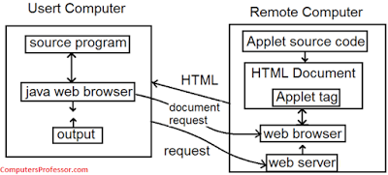
The corresponding applet is transferred to the user computer.
The Java enabled browser on the users computer interprets the byte code and provide output.

Slide 21
Web Browsers
A web browser is a software application that people use in order to view web pages on the internet.
It can be used to upload or download files on FTP servers.
It uses security methods such as SSL and TLS to secure internet traffic.
It also uses cookies to store information and it caches web pages to make internet surfing more efficiently.

Slide 22
Working of Java Prog.
All source code is first written in plain text files ending with the .java extension.
Those source files are then compiled into .class files by the javac compiler.
A .class file does not contain code that is native to your processor; it instead contains bytecodes
Bytecode is highly optimized set of instruction design to execute by java run time system, also known as Java Virtual Machine (Java VM).

Slide 23
Java Virtual Machine
Java in order to support security and portability, does not compile the source code to executable code.
JVM mainly performs following operations.
Allocating sufficient memory space for the class properties.
Provides runtime environment in which java bytecode can be executed
Converting byte code instruction into machine level instruction..

Slide 24
JVM……Cont
JVM is separately available for every Operating System while installing java software so that JVM is platform dependent.
Java is platform Independent but JVM is platform dependent because every Operating system have different-different JVM which is install along with JDK Software.

Slide 25
What is JIT Compiler
Just-In-Time
JIT is the set of programs developed by SUN Micro System .
Added as a part of JVM, to speed up the interpretation phase.

Slide 26
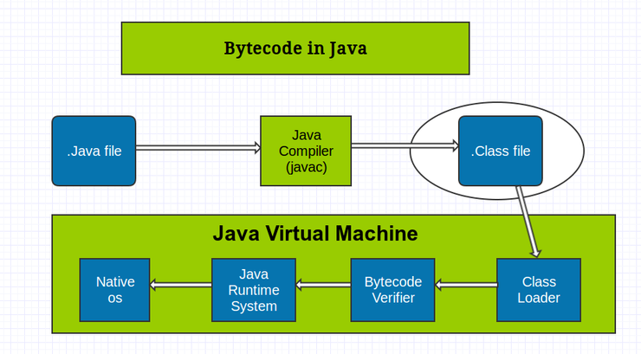

Slide 27
Data Types – Signed and Unsigned
Java does not support unsigned data types.
The byte, short, int, and long are all signed data types.
For a signed data type, half of the range of values stores positive number and half for negative numbers, as one bit is used to store the sign of the value.
Notes:
Signed data types can hold both positive and negative values.
Unsigned data types can hold large positive values but cannot hold negative values.
signed data type can store both negative and positive values and unsigned data type can store only positive values including zero.

Slide 28
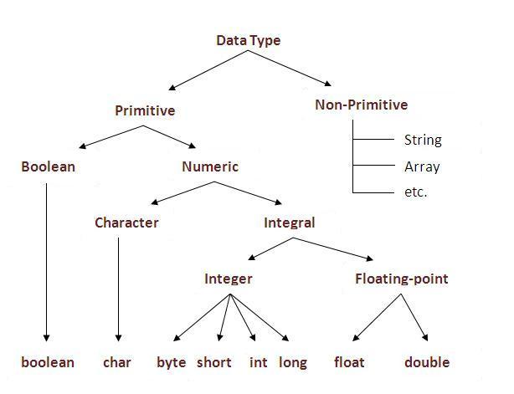

Slide 29
Data Types and Size- Primitive
Type | Size in Bytes | Range
byte | 1 byte | -128 to 127
short | 2 bytes | -32,768 to 32,767
int | 4 bytes | -2,147,483,648 to 2,147,483, 647
long | 8 bytes | -9,223,372,036,854,775,808 to 9,223,372,036,854,775,807
float | 4 bytes | approximately ±3.40282347E+38F (6-7 significant decimal digits) Java implements IEEE 754 standard
double | 8 bytes | approximately ±1.79769313486231570E+308 (15 significant decimal digits)
char | 2 byte | 0 to 65,536 (unsigned)

Slide 30
Default Values of Primitive data Types
Type | Default Value
byte | 0
short | 0
int | 0
long | 0
float | 0.0f
double | 0.0d
char | '\u0000'
boolean | false
String or other object | null
Notes:
Why char uses 2 byte in java and what is \u0000 ?
It is because java uses Unicode system than ASCII code system. The \u0000 is the lowest range of Unicode system.

Slide 31
Data Types and Size- User Defined
Java uses UNICODE system.
Classes – creating object of class
Example
Student s = new Student();
Interfaces

Slide 32
Basic of Java
The Java programming language defines the following kinds of variables:
local variable - A variable which is declared inside the method is called local variable.
instance variable - A variable which is declared inside the class but outside the method, is called instance variable . It is not declared as static.
static variable -
Naming:
May contain numbers, underscore, dollar sign, or letters
Can not start with number
Can be any length
Reserved keywords cant used as a variable.
Case sensitive
White space is not permitted.

Slide 33
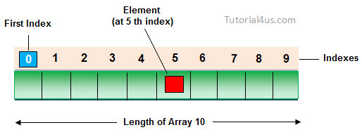
Arrays
Every array in a Java is an object, Hence we can create array by using new keyword.
int[] arr = new int[10]; // The size of array is 10. or
int[] arr = {10,20,30,40,50};

Slide 34
multi-dimensional array
Rows and columns in the table
Two Dimensional Array
double[][] a = new double[m][n];
The same notation extends to arrays that have any number of dimensions.
double[][][] a = new double[n][n][n];

Slide 35
Alternative Array Declaration Statements
int[][] intArray = new int[10][20];
intArray[0][2] = 129;
int oneInt = intArray[0][2];
int[] intArray = new int[10];
String[] stringArray = new String[10];

Slide 36
Control Statements
To change the execution order of program
As the method of controlling the execution order
Conditional Statement : if, if-else, switch.
Repeat Statement : for, while, do-while.
Branch Statement : break., continue, return.

Slide 37
Conditional Statement - if Statement
Form of if Statement
if ( <conditional expression> ) <statement>
if ( < conditional expression > )
<statement1>
else <statement2>
Result of conditional expression:
Logical Type(true or false)

Slide 38
The if - branching statement
if ( x < y) {
x = y;
}
If x=55 and y = 65
Then x become 65
if ( x < y ) { x = y; } else { x = 88; }
If x=55 and y = 45
Then x become 88

Slide 39
Conditional Statement - if Statement
Nested if statement
if (<cond. expr.>)
if (<cond. expr.>)
// . . .
<statement>
if (<cond. expr.1>) <statement 1>
else if (<cond. expr.2>) < statement 2>
…
else if (<cond. expr. n>) < statement n>
else < statement>

Slide 40
Nested IF
if ( x < 0 ) { System.out.println( “ x is negative “ ); }
else { if ( x > 0 ) { System.out.println ( “x is positive” ); } //end if x > 0 else { System.out.println ( “x is zero “ ); }
} //end else x >=0

Slide 41
Conditional Statement - switch Statement
Form of switch statement
switch ( <expr.> ) {
case <const. expr. 1> : <statement 1> <break>
case < const. expr. 2> : < statement 2> <break>
case < const. expr. n> : < statement n> <break>
default : < statement> <break>
}

Slide 42
Nested Switch Case
case 3: switch( branch ) // LINE D { case 'C': ………………. break; case 'E': ………………. break; case 'M': ……..……….
break; } break; }
switch( year)
{ case 1:
………………. break; case 2: switch( branch ) // LINE C { case 'C': ………………. break; case 'E': …………….. break; case 'M': …………….. break; } break;

Slide 43
Declaring Loop Control Variables Inside the for loop
Repeat the sequence of statement as many as defined.
Form of for statement
for ( <expr. 1> ; < expr. 2> ; < expr. 3>)
<statement>
<expr. 1> : initialize the control variable
<expr. 2> : check the control variable
<expr. 3> : modify the control variable
s = 0;
for (i=1; i<=N; ++i) // sum from 1 to N : i increment
s += i;

Slide 44
Using comma in for loop
for (int i=0,j=0; i< squares.length; i++)
int[ ] squares = {0, 1, 4, 9, 16, 25};
for (int i : squares) {
System.out.printf("%d squared is %d.\n", j++, i);
}

Slide 45
For-each Loop
The for-each loop is used to traverse array or collection in java.
It works on elements basis not index. It returns element one by one in the defined variable.
int arr[ ]={12,23,44,56,78};
for(int i:arr){
System.out.println(i);
}

Slide 46
Jump Statements -Labeled Break
The break statement has two forms: labeled and unlabeled
Unlabeled break can be used to terminate a for, while, or do-while loop or in switch statement.
An unlabeled break statement terminates the innermost switch, for, while, or do-while statement, but a labeled break terminates an outer statement.
The presence of a label will transfer control to the start of the code identified by the label.

Slide 47
INNER: for(int j = 0; j<numbers.length; j++){ System.out.println("Even number: " + i + ", break from INNER "); break INNER; }
search:
for (i = 0; i < arrayOfInts.length; i++) {
for (j = 0; j < arrayOfInts[i].length; j++)
{
if (arrayOfInts[i][j] == searchfor)
foundIt = true; break search;
}
}

Slide 48
Jump Statements - Labeled Continue
Unlabeled continue statement: is used to skip the following statement in the body of the loop when specific condition returns true.
Labeled continue Statement: is used to skip the following statement in the body of the specific loop based on the label when specific condition returns true.

Slide 49
OUTER: //outer label for(int i = 0; i<numbers.length; i++){ if(i % 2 == 0){ System.out.println("Odd number: " + i + ", continue from OUTER "); continue OUTER; } }
Outer:
for(int i=0; i < intArray.length; i++)
{
for(int j=0; j < intArray[i].length ; j++)
{
if(intArray[i][j] == 3)
continue Outer;
System.out.println("Element is : " + intArray[i][j]);
}
}

Slide 50
aa:
for(int i=1;i<=3;i++){
bb:
for(int j=1;j<=3;j++){
if(i==2&&j==2){
break aa;
}
System.out.println(i+" "+j);
}
}
}
OUTPUT:
1 1
1 2
1 3
2 1

Slide 51
String Handling
Strings are treated as objects.
String greeting = "Hello world!";
String class is encapsulated under java.lang package.
string objects are immutable that means once a string object is created it cannot be altered.
Notes:
What is an Immutable object?
An object whose state cannot be changed after it is created is known as an Immutable object. String, Integer, Byte, Short, Float, Double and all other wrapper class's objects are immutable.

Slide 52
Creating a String object
1) Using a String literal
String literal is a simple string enclosed in double quotes " ". A string literal is treated as a String object.
String str1 = "Hello"; 2) Using another String object
String str2 = new String(str1); 3) Using new Keyword
String str3 = new String("Java"); 4) Using + operator (Concatenation)
String str4 = str1 + str2; or, String str5 = "hello"+"Java";

Slide 53
String (Cont…)
String objects are stored in a special memory area known as string constant pool.
Example : char[] ch={'j','a','v','a','t','p','o','i','n','t'};
String s=new String(ch);
string objects are immutable. Immutable simply means unmodifiable or unchangeable.
Once string object is created its data or state can't be changed but a new string object is created.
The String class includes a method for concatenating two strings.

Slide 54
Concatenating Strings
string1.concat(string2);
"My name is ".concat("Zara");
"Hello," + " world" + "!"

Slide 55
String Class Methods
1. toUpperCase() and toLowerCase() method
String s="Sachin";
System.out.println(s.toUpperCase()); //SACHIN
System.out.println(s.toLowerCase()); //sachin
System.out.println(s); //Sachin(no change in original)
2. String trim() method
Eliminates white spaces before and after string.
String s=" Sachin ";
System.out.println(s); // Sachin
System.out.println(s.trim()); //Sachin

Slide 56
String Class Methods
3. startsWith() and endsWith() method
String s="Sachin";
System.out.println(s.startsWith("Sa")); //true
System.out.println(s.endsWith("n")); //true
4. charAt() method
It returns a character at specified index.
String s="Sachin";
System.out.println(s.charAt(0)); //S
System.out.println(s.charAt(3)); //h

Slide 57
String Class Methods
5. length() method
returns length of the string.
String s="Sachin";
System.out.println(s.length()); //6
6. valueOf() method
The string valueOf() method coverts given type such as int, long, float, double, boolean, char and char array into string.
int a=10;
String s=String.valueOf(a);
System.out.println(s+10); // 1010

Slide 58
String Class Methods
7. intern() method
Pool of strings, initially empty, is maintained privately by the class String.
When the intern method is invoked, if the pool already contains a string equal to this String object as determined by the equals(Object) method, then the string from the pool is returned.
Otherwise, this String object is added to the pool and a reference to this String object is returned.
String s=new String("Sachin");
String s2=s.intern();
System.out.println(s2); //Sachin

Slide 59
String Class Methods
7. replace() method
Replaces all occurrence of first sequence of character with second sequence of character.
String s1="Java is a programming language. Java is a platform. Java is an Island.";
String replaceString=s1.replace("Java","Kava");
System.out.println(replaceString);
Kava is a programming language. Kava is a platform. Kava is an Island.

Slide 60
^{Running Java Program}

Slide 61
Notes before starting java prog.
Every java program must have at least one class.
Each class begin with class declaration that define data and method for class.
Name given to source file should be filename.java
All code must be reside in a class including main method.
Name of class should be match with file name of the file that hold source code.

Slide 62
Skeleton Java class
public class Skeleton{
public static void main(String[] args){
// early in the course, all your code will go here, inside themain method
} // end main method
} // end class

Slide 63
First Java Program
/*first application, only output. */
import java.io.*;
public class hello {
public static void main (String [ ] args) {
System.out.println(“ Welcome to Java”);
} //end main
}//end class

Slide 64
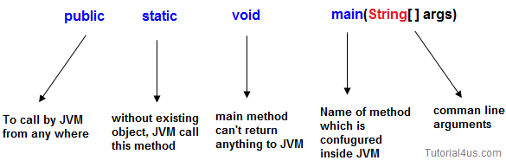
Main() Method in Java
We can declare String[] in any valid form.
String[] args
String args[]
String []args
Notes:
Public
public is a keyword in a java language whenever if it is preceded by main() method the scope is available anywhere in the java environment that means main() method can be executed from anywhere. main() method must be accessed by every java programmer and hence whose access specifier must be public.
Static
static is a keyword in java if it is preceded by any class properties for that memory is allocated only once in the program. Static method are executed only once in the program. main() method of java executes only once throughout the java program execution and hence it declare must be static.
Void
void is a special datatype also known as no return type, whenever it is preceded by main() method that will be never return any value to the operating system. main() method of java is not returning any value and hence its return type must be void.
String args[]
String args[] is a String array used to hold command line arguments in the form of String values.

Slide 65
Comments
Ignored by the compiler and JVM
Used for documentation intended for programmers or other people involved in development

Slide 66
Comments
Line comment: A line comment is preceded by two slashes (//) in a line.
Paragraph comment: A paragraph comment is enclosed between /* and */ in one or multiple lines.
javadoc comment: javadoc comments begin with /** and end with */. They are used for documenting classes, data, and methods. They can be extracted into an HTML file using JDK's javadoc command.

Slide 67
Code in program
public class hello {
// your prog. Begin with a call to main()
}
The line use keyword class to declare a new class.
All member are reside inside { and } brace (including main method).

Slide 68
main Method
The main method provides the control of program flow. The Java interpreter executes the application by invoking the main method.
main often calls other methods, including ones that are in other classes
The main method looks like this:
public static void main(String[] args) {
// Statements;
}

Slide 69
System.out.println(“ ”);
The simplest way to show output
By default, prints to the command console
System.out.println("Hello, World!");
prints the message “Hello, World!”
System.out.println(i)
prints the value of a variable named i
System.out.println("i = " + i);
prints the literal text "i =" followed by the value of I
if the value of i is 1 at the time the statement executes, prints “i = 1”

Slide 70
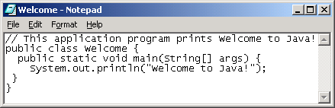

Creating and Editing Using NotePad
To use NotePad, type
notepad Welcome.java
from the DOS prompt.

Slide 71
Running Java Programs
Java source code is stored in plain text files with .java file name extension.
You can save them on a flash drive or to server space or email them to yourself.
Write your java program with a text editor like notepad, wordpad, netbean etc...
Save as plain text using extension .java

Slide 72
Running Java Programs
Open a command prompt and navigate to the folder where you saved the file
Type javac filename.java to compile your java program
for example, if the program file is called Hello.java, then type
javac Hello.java
Type java filename to run your java program
For example, if if the program file is called Hello.java, then type
java Hello

Slide 73
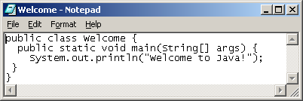
Creating, Compiling, and Running Programs

Slide 74
Java program goes thorough following phases
Edit
Use editor to create prog.
Compile
Java translate the java code to bytecode.
Loading
It done by class loader also known as java interpreter.
It translate the file containing byte code to memory.
Verifier/verify
Verify the bytecode to ensure that bytecode are valid or not.
Execute
Run the code to get desired output.

Slide 75
THANK YOU

